Slide 1
Neon Training Course for Dolby
Cliff Parris
ESPICO Ltd
September 2009

Slide 2
Agenda – Day1
Introduction to the ARM Cortex A8
ARM integer instructions
Cortex A8 compared to 9E
The Neon ISA
RVDS 4.0 Issues
Implementation of synthesis PolyphaseFilteringSlot( )
Part 1:Design

Slide 3
Agenda- Day 2
Implementation of SynthesisPolyphaseFilteringSlot( )
Part 2:Implementation/Verification
Implementation of AnalysisPolyphaseFilteringSlot( )
Implementation of DCTII/DCTIII( )
Part 1: Pre and Post twiddles

Slide 4
Agenda – Day 3
Implementation of DCTII/DCTIII( )
Part 2: FFT
Discussion on ApplyPsSlot()
Discussion on CalculateSbrEnvelope()
Discussion on LppTransposer()

Slide 5
Introduction to ESPICO
Formed in 1999
Specialise in speech and audio implementations on licensable cores
Traditionally DSP Cores: Ceva, ZSP, ARC etc
Implemented HE-AAC+/DAB+
Implemented GSM vocoder suite on NEON

Slide 6
Introduction to ARM Cortex A8
ARM architecture v7-A instruction set.
64 or 128 bit AMBA for main memory interface.
16KB or 32KB L1 instruction and data caches
0, 128 through 1MB L2 unified cache

Slide 7
OMAP 3530
16K L1 Instruction and Data Caches
256K L2 Unified Cache
64-bit AXI

Slide 8
Programmers Model
Single instruction stream
Single view of memory
Single debug and trace
ARM handles control plane
Loops, branches and function calls
Address calculation
Hardware optimised for tight control
NEON handles data plane
Integer, Fixed-point and Floating-point processing
Hardware optimised for high throughput
D
ARM
NEON
I
Debug/Trace

Slide 9
Super-Scalar Operation
Dual issue on ARM
Only one MUL/MAC
Only one load/store
ARM dual issue with NEON
Limited dual issue on NEON
A8 only
‘Permute’ and first/last cycle of load/store instructions can be issued with data processing instruction

Slide 10
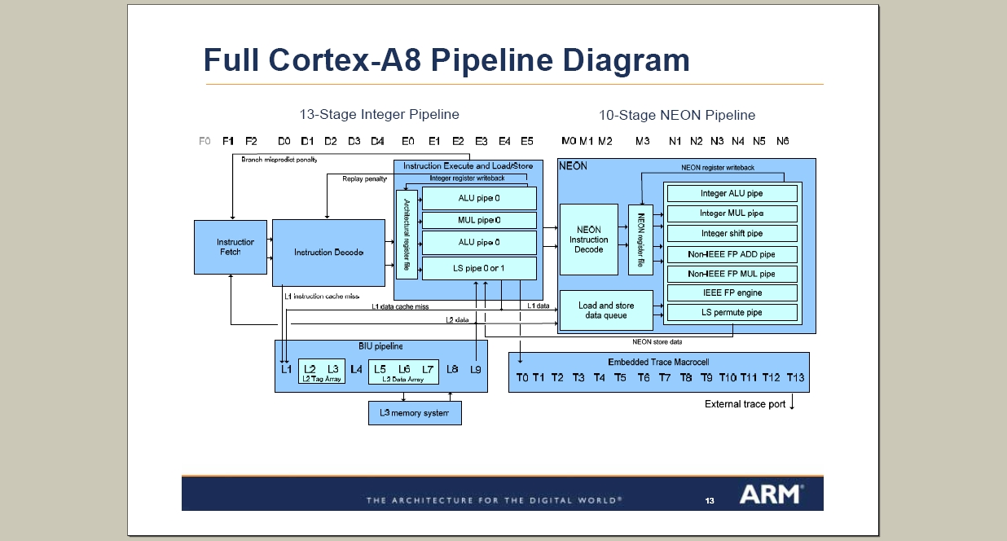

Slide 11
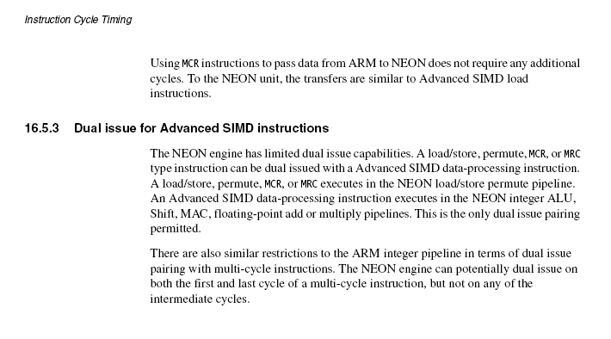
Dual Issue for SIMD

Slide 12
ARM Cortex A8 vs ARM 9E
i.e. v7 vs v5 ISA

Slide 13

NEON™ in the Architecture Roadmap
NEON™ is an Important Component to ARMv7 processors!
2004
ARMv7: NEON™
ARM Cortex Family
Improved Media & DSP increases system performance
Improved power usage and perf enable next gen portable devices
2003
ARMv6: TrustZone™, IEM*
Improving Security at the heart of connected devices
Increased Performance
2003
ARMv6T2: Thumb-2 ISA
Improved Code Density reduces System Cost
2002
ARMv6: SIMD Media ISA
Improved Media & DSP increases system performance
Lower system cost
2000
ARMv5TEJ: Jazelle®
Improved Java Performance matching market requirements
1998
ARMv5TE: DSP Instructions
Improved Media & DSP increases system performance
1995
ARMv4T: Thumb ISA
Improved Code Density reduces System Cost

Slide 14
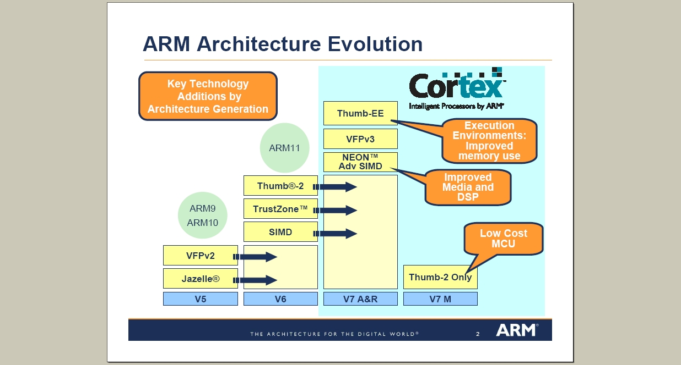

Slide 15
ARMv5 to v6
See arm architecture reference manual appendix G&H
All v5 instructions supported
New:
ARM v6 SIMD
Additional Thumb instructions
Kernel support, security options, hierarchical cache

Slide 16
ARM v6 to v7
See arm architecture reference manual appendix G&H
Advanced SIMD extension (NEON)
Thumb EE
VFPv3 (v6 was VFPv2)
Security extensions (Trust zone)

Slide 17
NEON - ISA
SIMD Engine
Operates on Vectors
Vectors correspond to Neon registers and can be 64 or 128 bits in length
Integer data types can be:
8 bit
16-bit
32-bit
64-bit
32-bit single precision floating point data types also supported

Slide 18
Neon – Dual View Register File
A 256-byte register file distinct from the core
Two explicitly aliased views
32 x 64-bit registers (D0-D31)
16 x 128-bit registers (Q0-Q15)
Vector length vs. entry trade-off
Registers hold vectors of like elements
8, 16, 32, 64-bit Integers
Single-precision Floating-point
D0
Q0
D1
D2
Q1
D3
:
:
D30
Q15
D31
64-bit
D0.U8
Q0.F32
128-bit

Slide 19
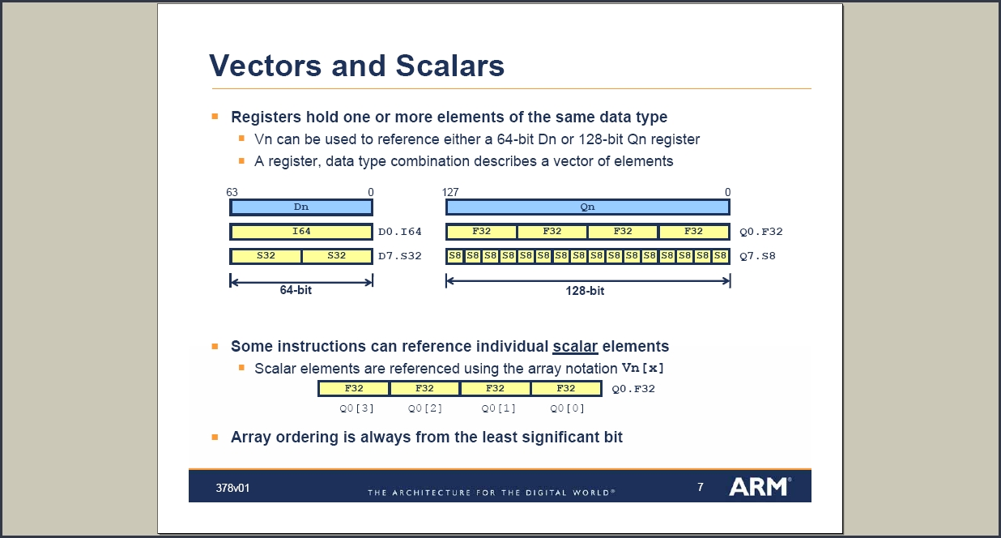

Slide 20
SIMD Framework
Instructions perform same operation in parallel
Dn
Qn
Dm
Qm
Dd
Qd
V{<mod>}<op>.<type> <Vd>, <Vn>, <Vm>
Add
VADD.I32 D0, D1, D2 VADD.F32 Q0, Q1, Q2 VQADD.S16 Q0, Q1, Q2
Shift Right
VSHR.U16 D0, D1, #5 VSHR.S16 D0, D1, #1 VRSHR.S32 Q0, Q1, #7

Slide 21
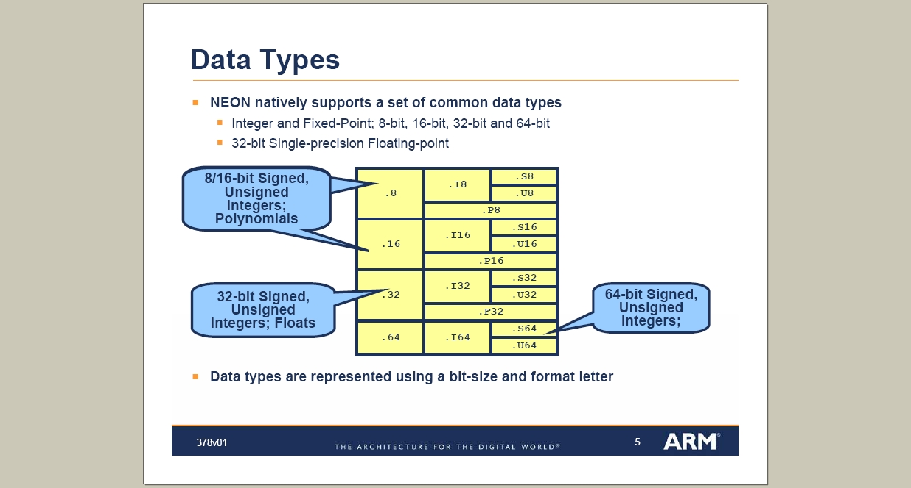

Slide 22
Fused Data Type Conversion
Promotion and demotion included in operations
Dual View enables efficient use of register file
Dn
Qn
Dm
#
Dd
Qd

Slide 23
Instruction Syntax #1
V{<mod>}<op>{<shape>}<.dt> <dest>, src1, src2
Highly Orthogonal but not all combinations supported
<op> - Instruction Operation
ADD, SUB, MUL, MLA, MLS, MAX, MIN, ABS, ABD, SHR, SHL, MOV
<mod> - Instruction Modifier(s)
Q: Use saturating arithmetic e.g. VQADD
H: Halve the result e.g. VHADD
D: Double the result e.g. VQDMUL
R: Rounding the result e.g. VRHADD
<Shape> - Operand promotion or demotion
L : Double operand width e.g. VQDMULL
N: Halve result width e.g. VQRSHRN
W: Double the width of the last operand e.g. VADDW
Notes:
ABD – Absolute difference

Slide 24
Instruction Syntax #2
V{<mod>}<op>{<shape>}<.dt> <dest>, src1, src2
<.dt> - Data Type
S16
S32
S64
U8
U16
U32
U64
F32

Slide 25
Example Instructions #1
VADDL.s16 Qd, Dn, Dm
For (i=0; i< 3;i++)
Qd[i] = (long)Dn[i] + (long)Dm[i]
Dn
Dm
Qd

Slide 26
Example Instructions #2
VADDW.s16 Qd, Qn, Dm
For (i=0; i< 3;i++)
Qd[i] = (Qn[i] + (long)Dm[i]
Qn
Dm
Qd

Slide 27
Example Instructions #3
VQDMULL.s16 Qd, Dn, Dm
For (i=0; i< 3;i++)
Qd[i] = SAT(((long)Dn[i] * (long)Dm[i]) << 1);
Dn
Dm
Qd

Slide 28
NEON - ISA
Slides from 378v02_NEON_ISA.ppt
Note: No 32 by 16 MUL/MAC on NEON
Use 32 by 32
2 cycles for 2 32x16 MUL/MACS
As used in OpenMax AAC for FFTs etc
Use 2 * 16 by 16 and add low and high results
2 cycles for 4 32x16 MUL/MACS
+ 2 cycles for >> 16 and add
No unsigned by signed mult options

Slide 29
NEON - ISA
VQDMULH.S32 – Fractional 32 by 32 returning high half (32 bit) is supported.
VQDMLAH.S32 – MAC version is not supported
Use VQDMLAL.S32 – 64-bit result followed by truncation or rounding to 32-bit

Slide 30
Optimising Neon Code
Pipeline and Stall mechanisms
Vectorization Examples

Slide 31
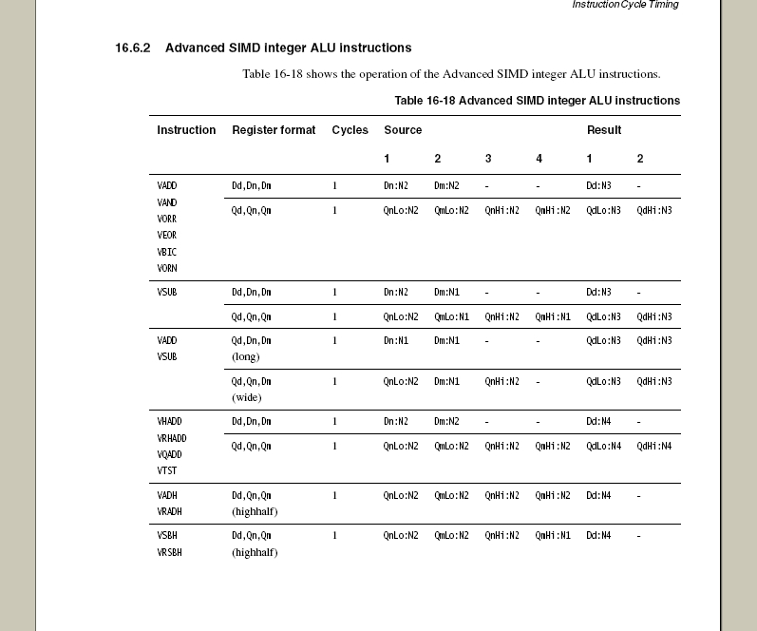
Instruction Cycle Timing #1
Notes:
Refer to Cortex A8 TRM

Slide 33
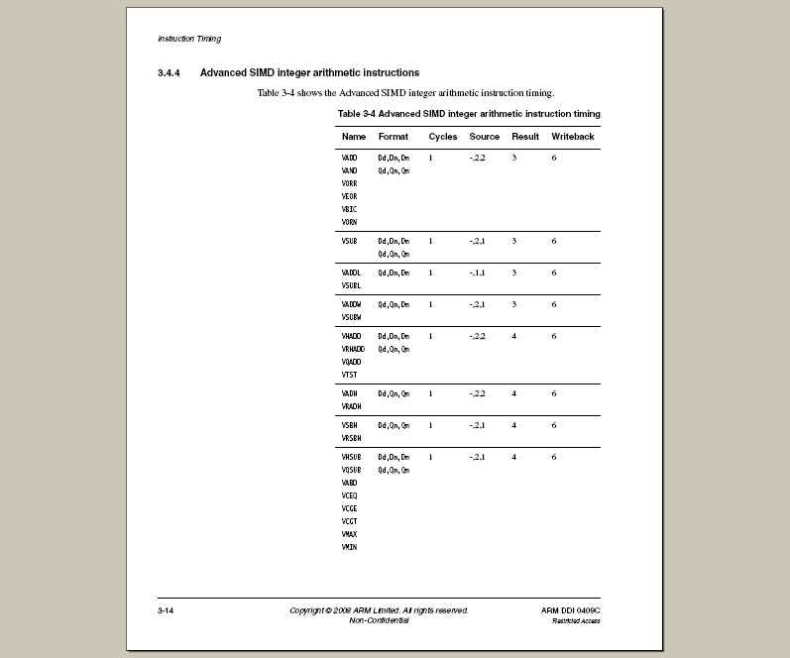
Instruction Cycle Timing #2

Slide 34
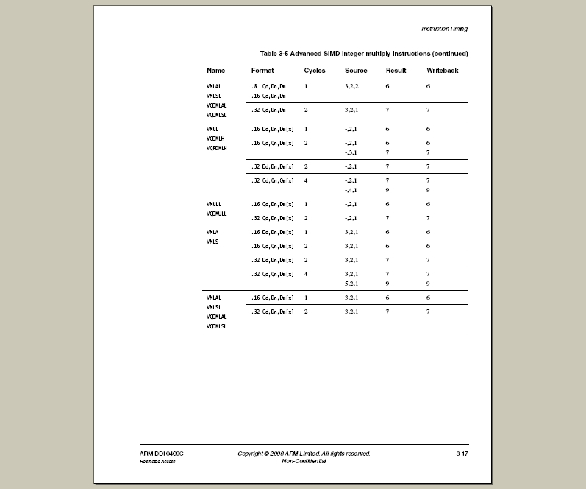
Instruction Cycle Timing #3

Slide 35
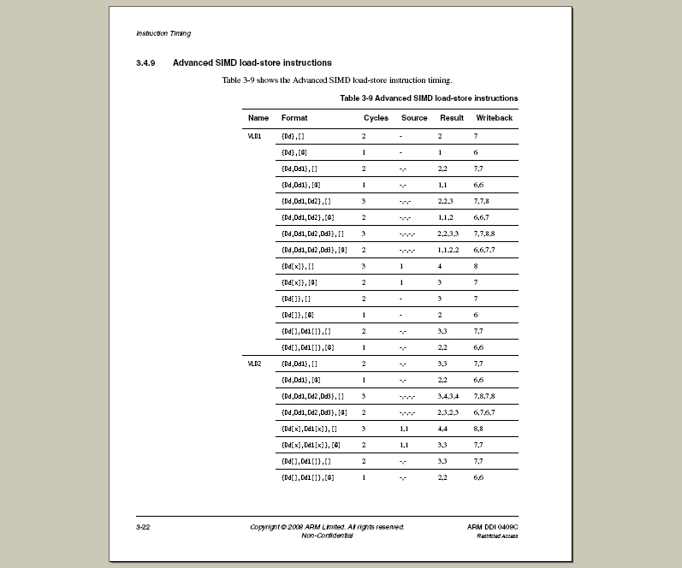
Instruction Cycle Timing #4

Slide 36
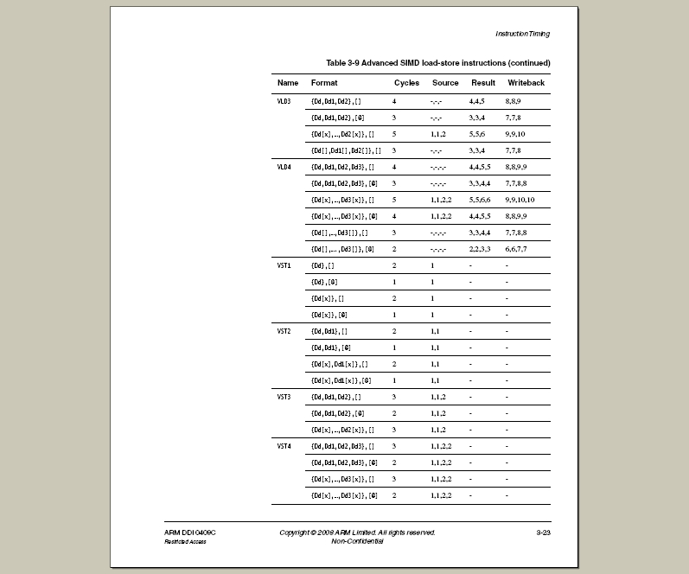
Instruction Cycle Timing #5

Slide 37
Instruction Cycle Timing #6
Potential stall cycles are determined by the difference between the result column of an instruction and the source column of a subsequent instruction which uses the result
e.g. storing MAC output
Typically 0 to 6 cycles unless programmer explicitly optimises the software
Loop unrolling and interleaving typically used to avoid pipeline stalls. Impacts code size.

Slide 38
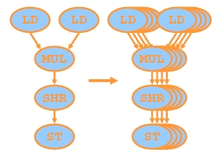
Optimising for NEON
Need to exploit packed SIMD
➔ Vectorize the code/algorithm.
Often as simple as just vectorize over loop index:

Slide 39
Vectorisation
Easy non-recursive algorithms (output depends only on input)
Difficult for recursive algorithms (output depends on previous outputs)
e.g. IIR filter, Entropy decoding.
Neon pipeline can also further degrade performance for small loops e.g.
Y[n] = 0.9*y[n-1] + x[n];

Slide 40
Optimisation - Example
FIR from SynthesisPolyphaseFilteringSlot( )
for (j=0; j< channels; j++)
{
/* Filtering */
accu = 0;
for(i=0;i<NO_POLY;i++)
{
statei = pFilterState16i[i*SBR_DOWNSAMP_FAC];
stater =pFilterState16r[i*SBR_DOWNSAMP_FAC+SBR_DOWNSAMP_FAC-1];
accu = CT_mac16x16ll(accu, statei, *pFilter++);
accu = CT_mac16x16ll(accu, stater, *--pFilterR);
}
}

Slide 41
Optimisation – Example #1
2*5 16-bit sequential loads for coeffs
2*5 16-bit non-sequential loads for data
stride is 2
10 mul/macs
First Question:
4 or 8 (D or Q) mul/macs per instruction so how do we partition the 10?
Initial answer is often to add across lanes

Slide 42
Optimisation – Example #2
cycle = 0
VLD1.16 {d15, d16}, [rX], rs1 ; load 5 coeffs from pFilter 2
VLD1.16 {d17, d18}, [rA], rs2 ; load 5 coeffs from pFilterR 4
VLD2.16 {d0, d1, d2, d3}, [rI], rs3 ; d0,d1 load 5 imag’ samples 7
VLD2.16 {d4, d5, d6, d7}, [rR], rs3 ; d4,d5 load 5 real samples 10
VQDMULL.S16 q14, d0, d15 ; 4 imag mults 15
VQDMULL.S16 q15, d1, d16 ; 5th 16
VQDMLAL.S16 q14, d4, d17 ; 4 real macs 17
VQDMLAL.S16 q15, d5, d18 ; 5th 18
VQADD.S32 d28, d28, d29 ; add partial products 18
VREV64.32 d29, d28 19
VQADD.S32 d28, d28, d29 ; add partial products 27
VQADD.S32 d28, d28, d30 ; add partial products 29
VQRSHRN.S32 d28, q14, #15 ; CT_rsnd(CT_sshl(accu, 1)) 33
VST1.16 d28[0], [rOut] ; store result 35
Notes:
VLD2 de-interleaves but need twice as many operands and takes an extra cycle
Cycle count is when instruction result is available
First VQDMULL is issued at cycle 7
Second VQDMULL is issued at cycle 11
VQADD needs source operands before cycle 16 but result of VQDMLAL not available until 11+6 = 18
So 14 instructions and 35 cycles of which 10 cycles are loads 2 cycles are store, 9 cycles are arithmetic and therefore 14 cycles of stalls
If we assume stalls can avoided (see later) then 21 cycles ignoring looping overhead

Slide 43
Optimisation – Example #3
‘Vectorise’ to allow data re-use
Reduces loading overhead
Reduces operations across lanes
Avoids possible source operand stalls
For Synthesis PolyPhase Filtering
Process all slots of given channel at once
Same Filter implies same coeffs and same state
Down-side may be additional buffering

Slide 44
Optimisation – Example #4
VQDMULL.S16 q15, d8, d0[0] ;# I1
VEXT.16 d16, d8, d9, #2 ; DUAL ISSUE
VQDMLAL.S16 q15, d12, d0[1] ;# R1
VEXT.16 d17, d12, d13, #2 ; DUAL ISSUE
VQDMLAL.S16 q15, d16, d0[2] ;# I2
VMOV d8, d9 ; DUAL ISSUE, delay line shift
VQDMLAL.S16 q15, d17, d0[3] ;# R2
VMOV d12, d13 ; DUAL ISSUE, delay line shift
VQDMLAL.S16 q15, d9, d1[0] ;# I3
VEXT.16 d16, d9, d10, #2 ; DUAL ISSUE
VQDMLAL.S16 q15, d13, d1[1] ;# R3
VEXT.16 d17, d13, d14, #2 ; DUAL ISSUE
VQDMLAL.S16 q15, d16, d1[0] ;# I4
VMOV d9, d10 ; DUAL ISSUE, delay line shift
VQDMLAL.S16 q15, d17, d1[1] ;# R4
VMOV d13, d14 ; DUAL ISSUE, delay line shift
VQDMLAL.S16 q15, d10, d1[0] ;# I5
SUBS r0, r0, #4 ; DUAL ISSUE loop counter
VQDMLAL.S16 q15, d14, d1[1] ;# R5
VQRSHRN.S32 d28, q15, #15 ; CT_rsnd(CT_sshl(accu, 1))
VST1.16 d28[0], [r1], r2 ; store single slot for this channel
VST1.16 d28[1], [r1], r2 ; store single slot for this channel
VST1.16 d28[2], [r1], r2 ; store single slot for this channel
VST1.16 d28[3], [r1], r2 ; store single slot for this channel
Notes:
10 mul/macs, delay line update for FREE via dual issue
1 arthimetic
8 store cycles
Again ignoring stalls/looping overhead
So 19 cycles == <5 cycles per slot

Slide 45
Programming Hints #1
Avoid Neon to ARM data transfers
VMOV ~ 20 cycles
Following a VMOV accessing any ARM reg’ will cause stalls
Can execute NEON instructions however.
Via Memory > 20 cycles
Avoid mixing NEON and ARM accesses to the same cache line (64-bytes).

Slide 46
Programming Hints #2
Turn L1NEON on
L1 caching for NEON writes
Use aligned loads and stores where possible
Exception if you get it wrong!
Use L2 data preload engine (PLD) if you know data is not in the caches.

Slide 47
Programming Hints #3
Consider merging consecutive processing stages
Especially for small recursive loops e.g.
Y[n] = 0.9*y[n-1] + x[n];
Reduces I/O overheads.

Slide 48
A8/A9 Differences
A9:
No NEON dual issue.
FPU is pipelined (VFPlite in A8)
No direct path to L2
Earlier in ARM pipeline
NEON to ARM transfers are faster

Slide 49
RVDS 4.0 Issues
ESPICO Development Flow
C Calling Procedure
Use of Profiler
Comments on cycle accurate simulation/emulation

Slide 50
ESPICO Development Flow
Bit Exact Reference C Code
Common code with ARM Platform where possible
Provides a reference for debug
Don’t use Vectorising C Compiler
Vectorise algorithm & C code ourselves.
Then write in ASM

Slide 51
C Calling Procedure
Assuming you are not using vectorising C compiler
C code runs on ARM11
ASM code runs of ARM11 + NEON
Push/Pop r4 to r11 + LR
Push/Pop NEON d8 to d15 (q4 to q7)
Once at top level.
SP should be 64-bit aligned – EABI Compliance

Slide 52
Profiling
RVDS Profiler does not model NEON pipeline or memory sub-system.
Cycle count can not be relied on.
ARM no longer provide cycle accurate simulators.
Cycle accurate simulator available in SOC designer from carbon design systems.

Slide 53
Hardware Methods
ICE-Trace
ARM pipe only, no visibility of NEON pipeline
Cortex-A8 PMU:
Counter runs at full processor speed.
May need OS patch, e.g. Linux
MRC p15, 0, <Rd>, c9, c12, 0 ; read PMNC
MCR p15, 0, <Rd>, c9, c12, 0 ; write PMNC (can set CCNT to zero by writing a bit here)
MRC p15, 0, <Rd>, c9, c13, 0 ; Read CCNT Register
MCR p15, 0, <Rd>, c9, c13, 0 ; Write CCNT Register

Slide 54
Beware Benchmarks!
Need to know how they can be reproduced.
Simulator /Hardware ?
Memory/Cache ?
A8/A9 ?

Slide 55
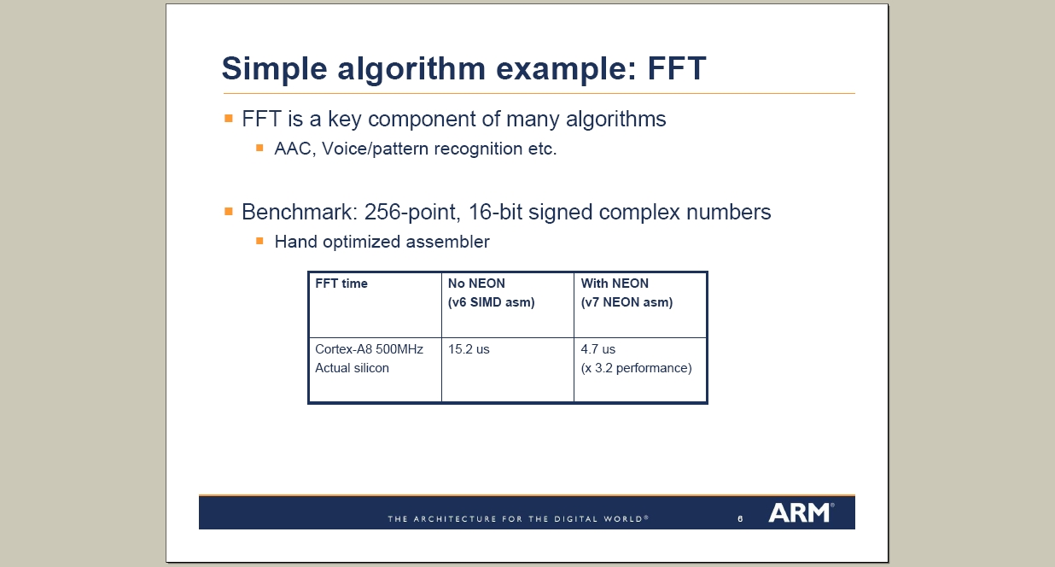

Slide 56
FFT Benchmarks
Previous ARM figure: 2350 cycles (256 pt, complex, 16-bit)
Other ARM figure: 3200 cycles (16-bit) / 6900 cycles (32-bit) 256 pt complex
Est 512 pt would be 2.25 times = 15525 cycles
ESPICO (OpenMax DL Libraries), 512 pt complex, measured on Beagle Board under Linux, Average over 100 consecutive calls: ~18500 cycles

Slide 57
